Slide 1
Customer Alerts
March 2012

Slide 2
What Are Customer Alerts?
Customer Alerts allows HSBCnet Users to create scheduled alert notifications for the following activity:
Balance & Transaction Reporting
Supports UK OLAM, US OLAM & HUB countries
File Upload Activity
Payment Instruction Activity
Positive Pay Activity
Self Service Requests
Supply Chain Solution Events
User Management Activity**
Notes:
User Management activity includes the following:
New User registration awaiting setup and/or authorisation
User Profile or Entitlement change awaiting authorisation
Only applicable for customers set to DUAL authority.
A submitted Security Information Reset (Off-line) request awaiting approval
Reactivation or Deletion of User
Only applicable for customers set to DUAL authority
Smartcard and Security Device management activity

Slide 3


Why Customers Use It
Allows customers to receive timely updates for account balance information, payment instructions, uploaded payment files, service requests and User management requests awaiting authorisation, without having to logon to HSBCnet.
Another added benefit of these alerts is that a User can be notified of when they need to log on and action (authorise, repair, review, etc..) an instruction, enhancing the customer’s internal processes in submitting instructions/service requests to the Bank for action.

Slide 4
Setup & Entitlements

Slide 5
Setup & Entitlements
Staff Hexagon
Add the following services to customer service template
Customer Alerting
HSBCnet
Within ‘User Management Tool’, entitle users to
Customer Alerts

Slide 6
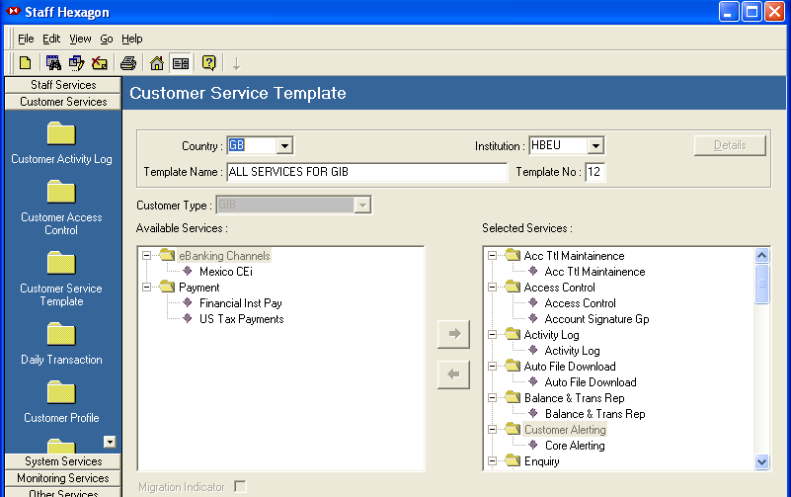
Setup & Entitlements – Staff Hex
“Customer Alerting” must be added to the Customer Service Template

Slide 7
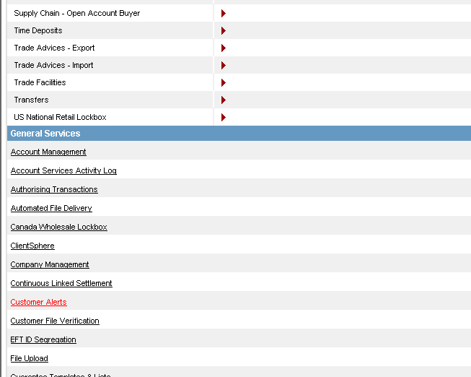
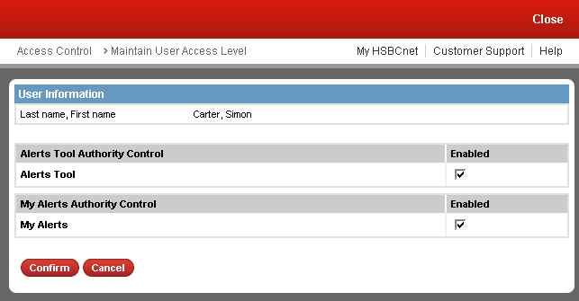
Setup & Entitlements – HSBCnet
Two User level entitlement options are available. (Explained on following slide)

Slide 8
Setup & Entitlements – HSBCnet
The “Alerts Tool” entitlement allows a User to access three core alerting tools:
Create Scheduled Alerts
Triggered Alerts
Scheduled Alerts
The “My Alerts” entitlement allows a User to access the My Alerts tool

Slide 9
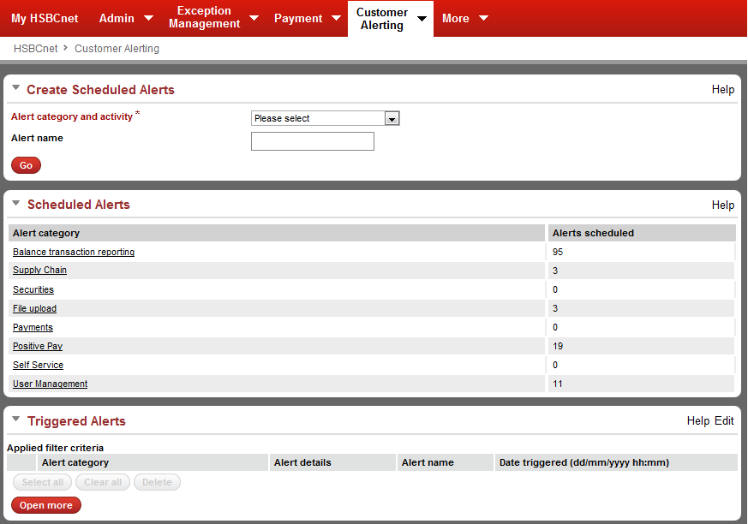
Setup & Entitlements – HSBCnet
The core alerting tools will appear under the “Customer Alerting” tab by default

Slide 10
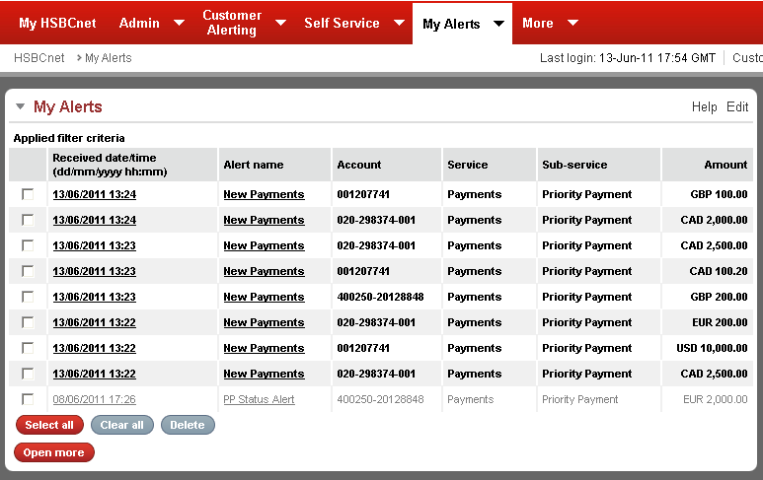
Setup & Entitlements – HSBCnet
By default, the “My Alerts” tool will appear under it’s own separate tab. (see note)
Notes:
Although the entitlement for the Core Alerts tools and My Alerts are under the same “Customer Alerts” entitlement section. The tools will appear under separate tabs by default.

Slide 11

What Are The Tools?

Slide 12
What Are The Tools?
Create Scheduled Alerts
Tool used to create new alert notification schedules
Triggered Alerts
Allows a user to view the SCS (Supply Chain Solution) event alerts which have been triggered
Scheduled Alerts
Allows customers to enquire on, modify or delete scheduled alerts
My Alerts
Allows a User to enquire on all triggered alert types (except for SCS events) for which their username is a designated recipient.

Slide 13
How Does It Work?

Slide 14
How Does It Work?
Alerts can be delivered via e-Mail or SMS*
SMS delivery option is only available for Payment, File Upload and Self Service alert types.
The mobile number used for delivery will be as specified in the selected User’s profile.
There is a maximum number of recipients per scheduled alerts:
Supply Chain Solution (SCS) alert types max of 50
User designated as “Main” recipient will receive all emails which bounce due to incorrect recipient details. **
All other alert types (Payment, File Upload, User Administration, etc…) max of 6.
The creation of a scheduled alert does not require authorisation.
Notes:
** Note **
Each email alert has a unique alert reference number, if 2 alert reference numbers are the same the main recipient will know that an email has bounced

Slide 15
Create Scheduled Alerts How Does It Work?

Slide 16
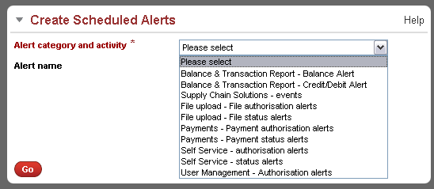
Create Scheduled Alerts
Select the type of alert you would like to create from the drop-down list. Then specify the name of the alert
Click to proceed

Slide 17
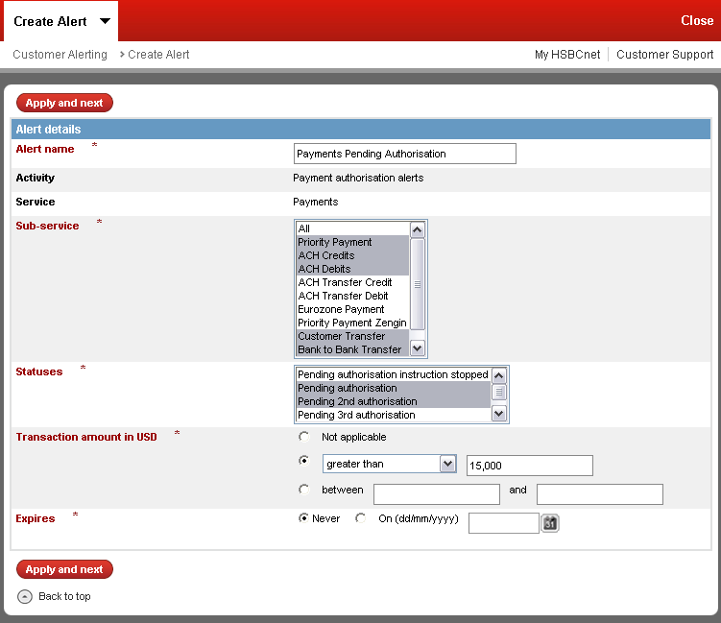
Create Scheduled Alerts
Specify the details of the alert to be created
When finished, click “Apply and next” to proceed.

Slide 18
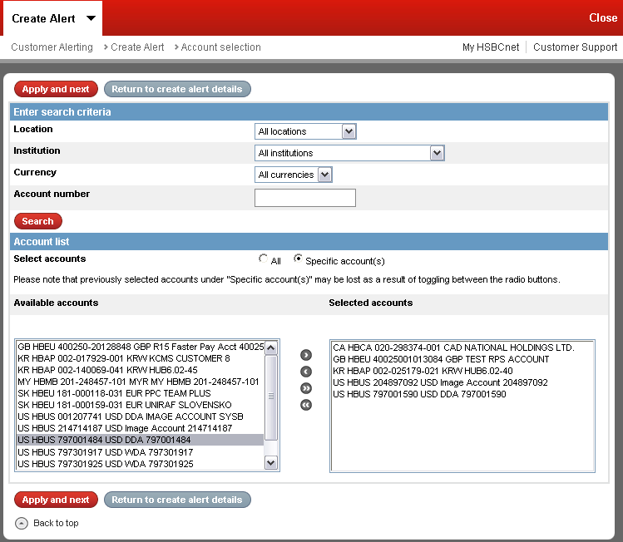
Create Scheduled Alerts
On the account selection stage, you can use the filter to search for specific accounts to be included in the alert criteria.
When selecting accounts, if the “Specific account(s)”option is selected, then use the account selection boxes below to specify which accounts to include in the alert criteria.

Slide 19
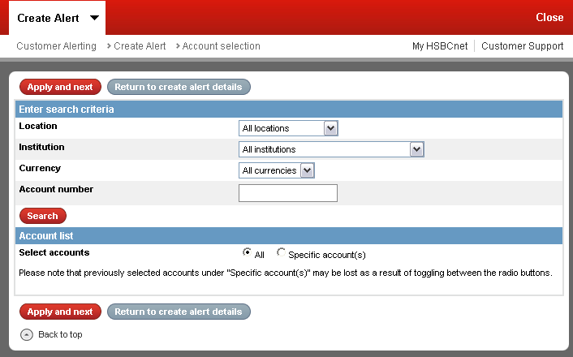
Create Scheduled Alerts
If the “All” option is chosen, then the account selection boxes will not be visible and all accounts (which the user is entitled to) will be included in the alert criteria.
When finished, click “Apply and next” to continue.

Slide 20
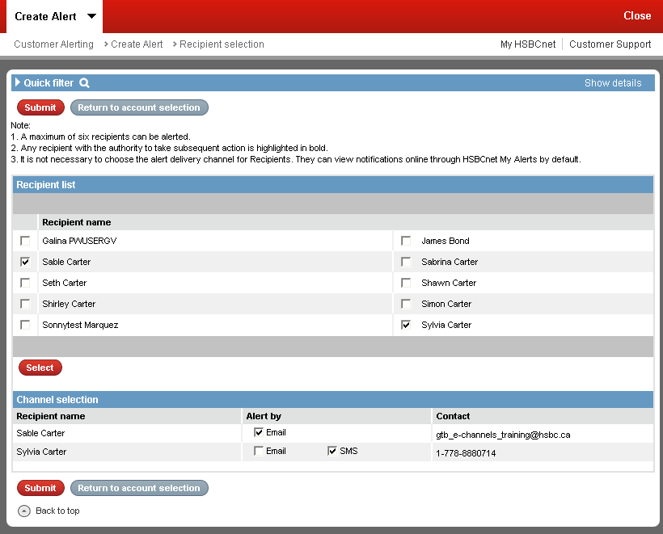
Create Scheduled Alerts
Quick filter is available to search for specific users to select as recipients
On the next step you will need to select the recipients for this alert (maximum of 6), check the box next to a user and then click “Select”
Now select the channel which should be used to alert the user (Email or SMS)
Click “submit” to proceed.
Notes:
Notes:
Only users with appropriate account level entitlements will be eligible to be selected as a recipient.
Users with appropriate account level entitlements on all the accounts selected in the previous step will be highlighted in bold text.
The Email address or Mobile number used will be as specified in the user’s profile.
The “SMS” option will only be available if SMS messaging is enabled in the user’s profile and a mobile number is specified.
Only one option can be selected for the user to be alerted by. A single user cannot be alerted by both Email and SMS.

Slide 21
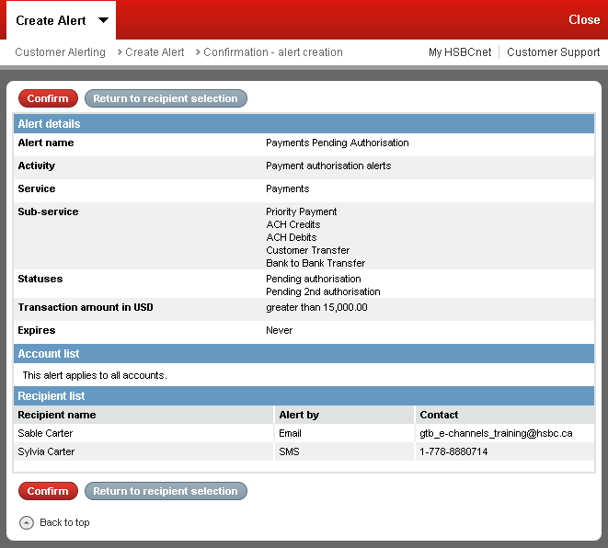
Create Scheduled Alerts
On the confirmation screen review the details of the new scheduled alert and click “Confirm” (at the top or bottom of the screen) to proceed.

Slide 22
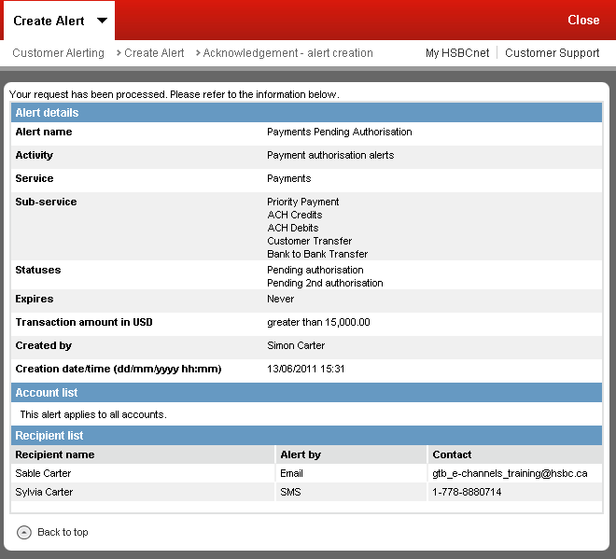
Create Scheduled Alerts
Once confirmed, an acknowledgement screen will appear indicating that the new scheduled alert has been created*
Notes:
Note:
Creation of scheduled alerts does not require authorisation.

Slide 23
Scheduled Alerts How Does It Work?

Slide 24
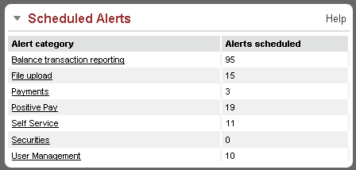
Customer Alerts Enquiry
Click an Alert category to view the scheduled alerts of that service.
The “Scheduled Alerts” tool allows you to view all the scheduled alerts created on your HSBCnet profile.
Notes:
Note:
All alerts are created at customer level meaning users with entitlements to Customer Alerts will be able to enquire on all scheduled alerts created on their customer profile.

Slide 25
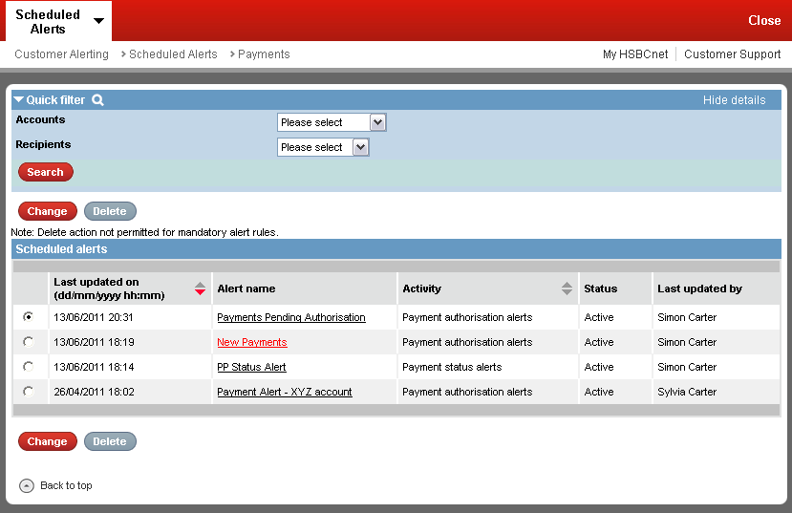
Customer Alerts Enquiry
Quick filter is available which will allow a user to refine the list of the alerts displayed below.
Click the “Alert name” to view the scheduled alert details.

Slide 26
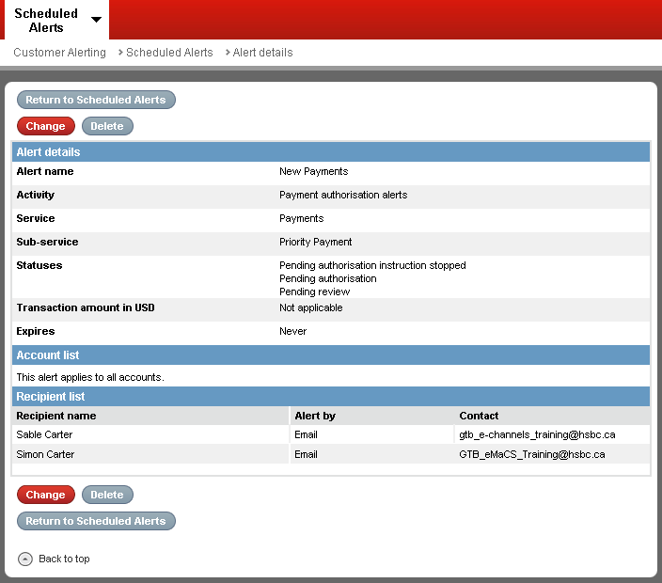
Customer Alerts Enquiry
From the scheduled alert details screen you will be able to Change(Modify) the alert criteria or delete the scheduled alert.

Slide 27
Triggered Alerts How Does It Work?

Slide 28
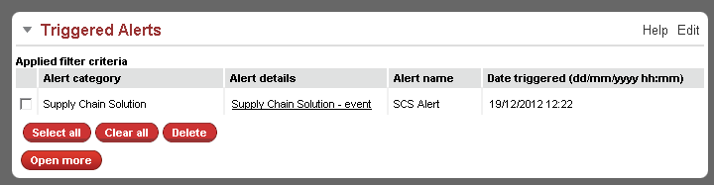
Triggered Alerts
Use Edit Tool to set Defaults for the Triggered Alerts Tool
Notes:
**Reminder**
The Triggered Alerts tool will report BTR, SCS and HSS activity only

Slide 29
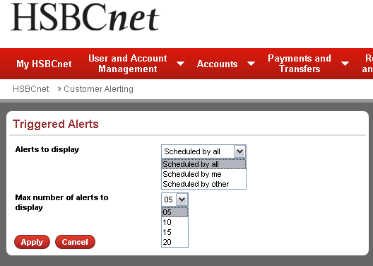
Triggered Alerts
Use the edit function to define the default settings for the Triggered Alerts tool, click “Apply” to save your changes

Slide 30
Triggered Alerts
Click on the Alert details to drill down to the account details that triggered the alert
Users can select individual alerts using the check box or the “Select all” action buttons and delete the alerts from view. Use the “Open more” option to view all triggered alerts

Slide 31
My Alerts How Does It Work?

Slide 32
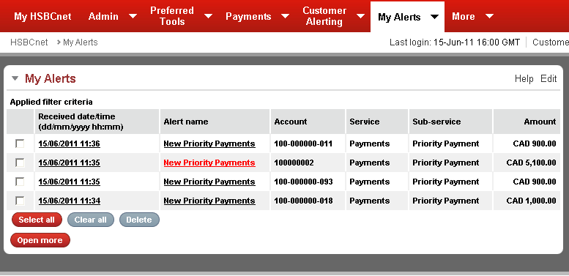
My Alerts
If a user has been designated as a recipient for any Payment, File Upload Self Service, or User Management alert, they will be able to see those alerts which have been triggered through the “My Alerts” tool.
Click the alert name to view the criteria which triggers the alert.
Notes:
Note:
Although the entitlement for the Core Alerts tools and My Alerts are under the same “Customer Alerts” entitlement section. The tools will appear under separate tabs by default.

Slide 33
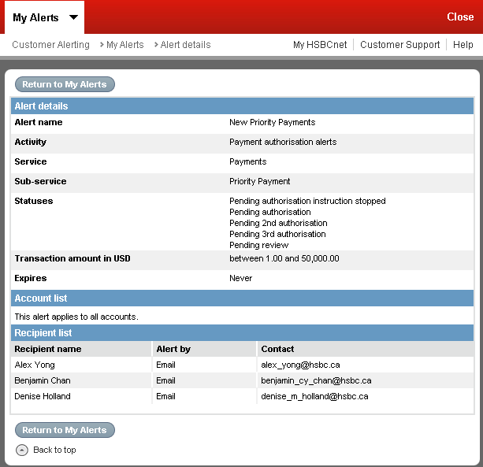
My Alerts
On the details screen, the User will be able to see the criteria which will trigger the alert.
User will also be able to see the recipient list as well as the method the recipient is alerted by.

Slide 34
Mandatory User Profile Change Alert How Does It Work?

Slide 35
Mandatory Profile Change Alert
The Mandatory Profile Change Alert will be generated when a change is made to any of the following fields within a User’s profile:
Email address at work
If the Email address is modified, the alert will be sent to the new Email address specified in the User’s profile.
Telephone number at work
Mobile telephone number
Address line 1
Postal code/Zip code
Unlike other scheduled alerts, System Administrators will have the ability to change the delivery channel only*. They will not be able to modify the alert criteria, nor delete the alert.
Additionally, this alert will also be generated and sent to advise Users when a new tool is ready for their use.
Notes:
Note*
Only System Administrators will be able to modify the delivery channel. End Users; even if they are entitled to the Alerts tools, will not be able to change or even see the mandatory alert criteria.

Slide 36
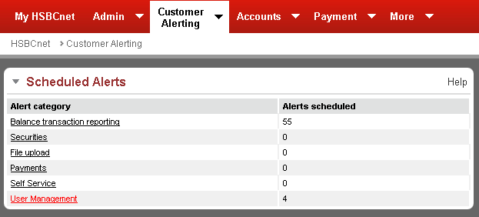
Scheduled Alerts
The mandatory profile change alert is located under the “User Management” category.

Slide 37
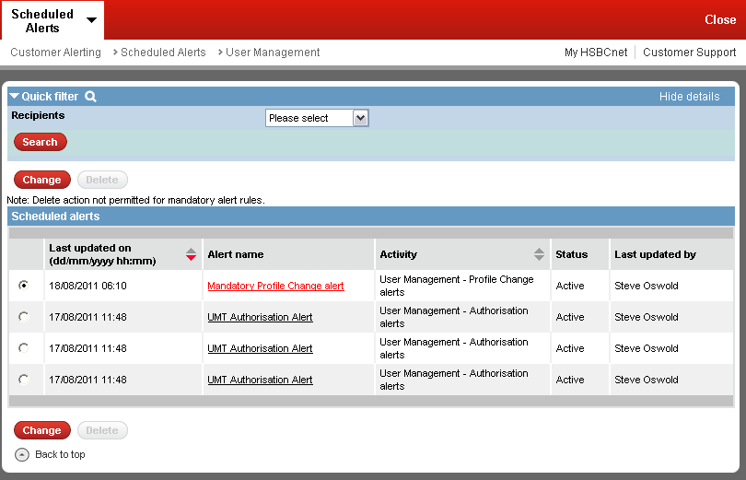
User Management Alert Summary
Click the name to view the details of the alert.**
Notes:
Note**
Only a System Administrator with entitlements to Customer alerts is able to modify the “Mandatory Profile Change alert”. End Users will not be able to modify this mandatory alert.

Slide 38
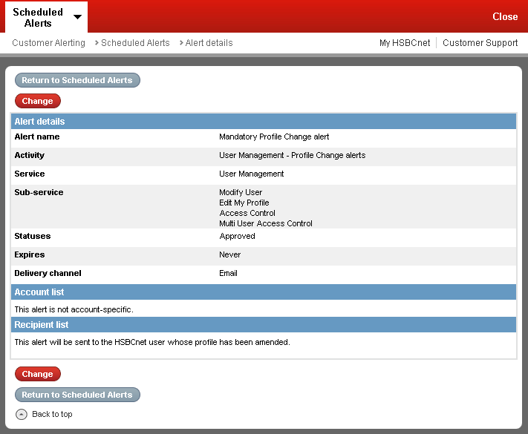
Mandatory Profile Change Alert – View
The default delivery channel for the mandatory profile change alert is “Email”
Unlike other scheduled alerts, the recipient list for this new alert is hardcoded to send an alert to the User whose profile has been amended.
Click to change the delivery channel.
Notes:
NOTE:
Since this alert is mandatory, the “Delete” option is not available on the Mandatory Profile Change alert details screen.

Slide 39
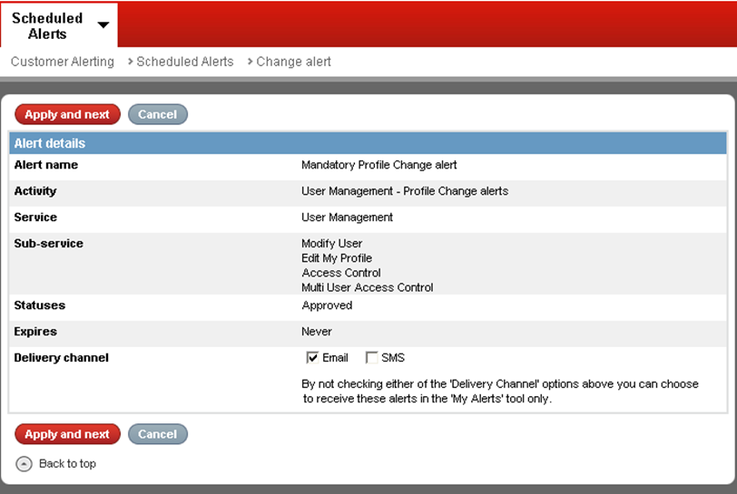
Mandatory Profile Change Alert – Edit
The Mandatory Profile Change Alert will be initially set to have “Email” as the delivery channel. Users can change the delivery channel to “SMS” by clicking the checkbox**
Notes:
Note:
The User can also deselect Email leaving both checkboxes blank. If neither delivery channel is selected, then the alert will appear in the “My Alerts” tool for the User who’s profile has been amended.

